Slide 1
Field of AI
Machine Learning
Essentially data analysis
Supervised learning (labelled data) -> regression, classification
Unsupervised learning (no labels) -> clustering, dimensionality reduction
Reinforcement learning (trial & error)
2. Deep learning
-Subfield of ML
-Specialized in neural networks
-Uses gradient descent and backpropagation to learn
-Enabled by GPUs + big data

Slide 2
Under Neural Network:
Machine Vision
-Convolutional Neural Networks (CNNs)
-Image recognition, localization (detection) and classification
2) NLP
-RNNs, LSTMs -> Early NLP like Siri
-Transformers-Uses self-attention algorithm
-Transformers enables LLMs and Generative AI
3) Diffusion Models
-GANs for generating images

Slide 3
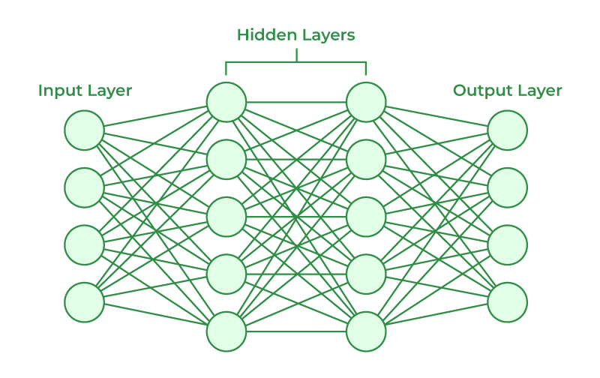
Model Training
Input Image
Outputs prediction:
[0.2,0.7,0.1]
Compute loss with loss function like Cross Entropy
Tell how wrong the model was
Backpropagation
Compute gradient of the loss with every weight
Tells each weight how much it contributed to the error
Use optimizer like Adam to update weights
Repeat for next batch

Slide 4
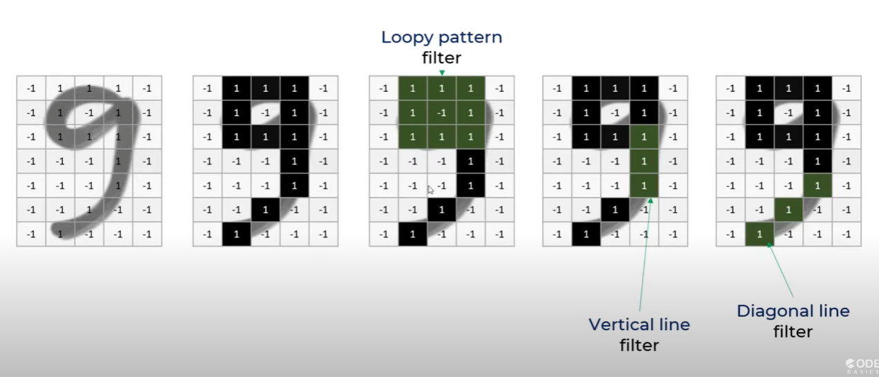

Slide 5
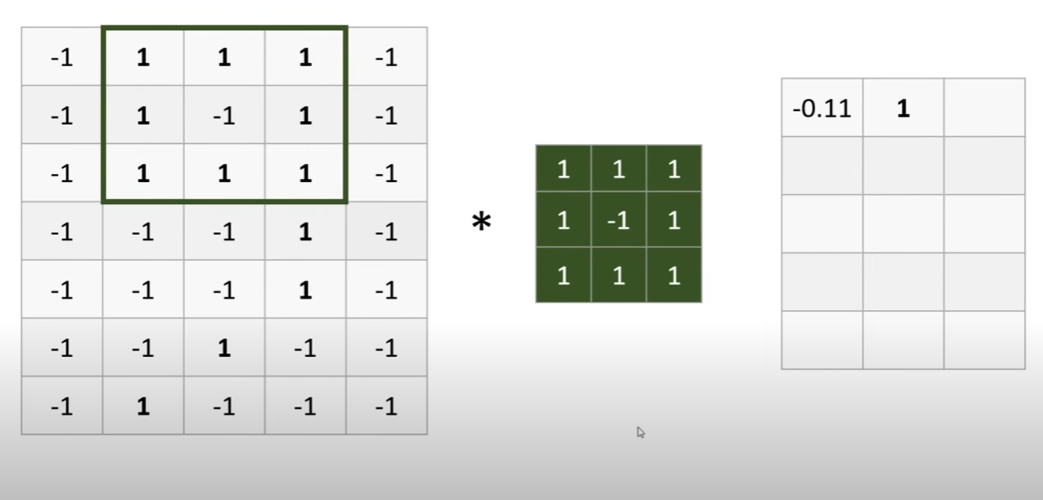
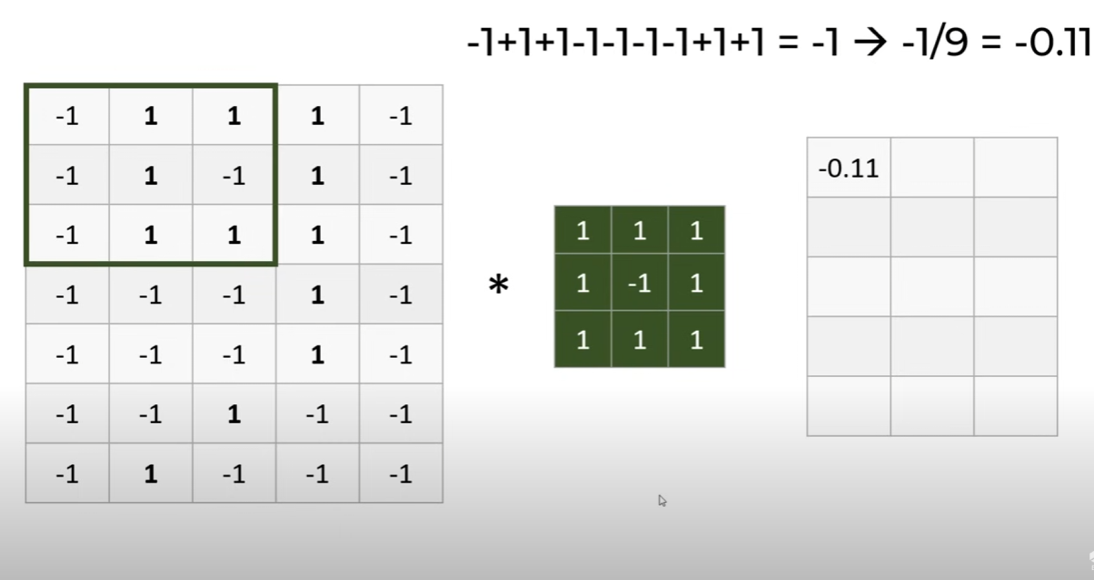
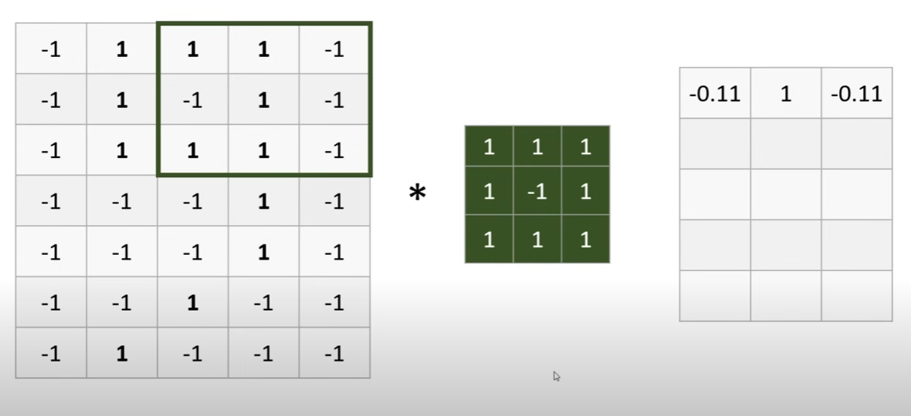
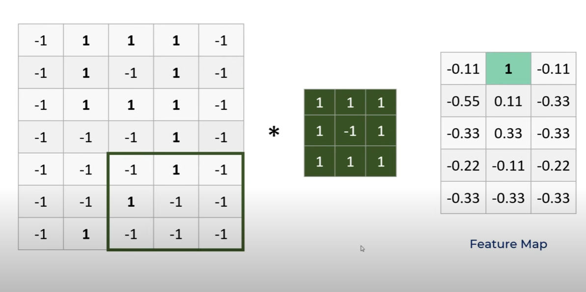

Slide 6
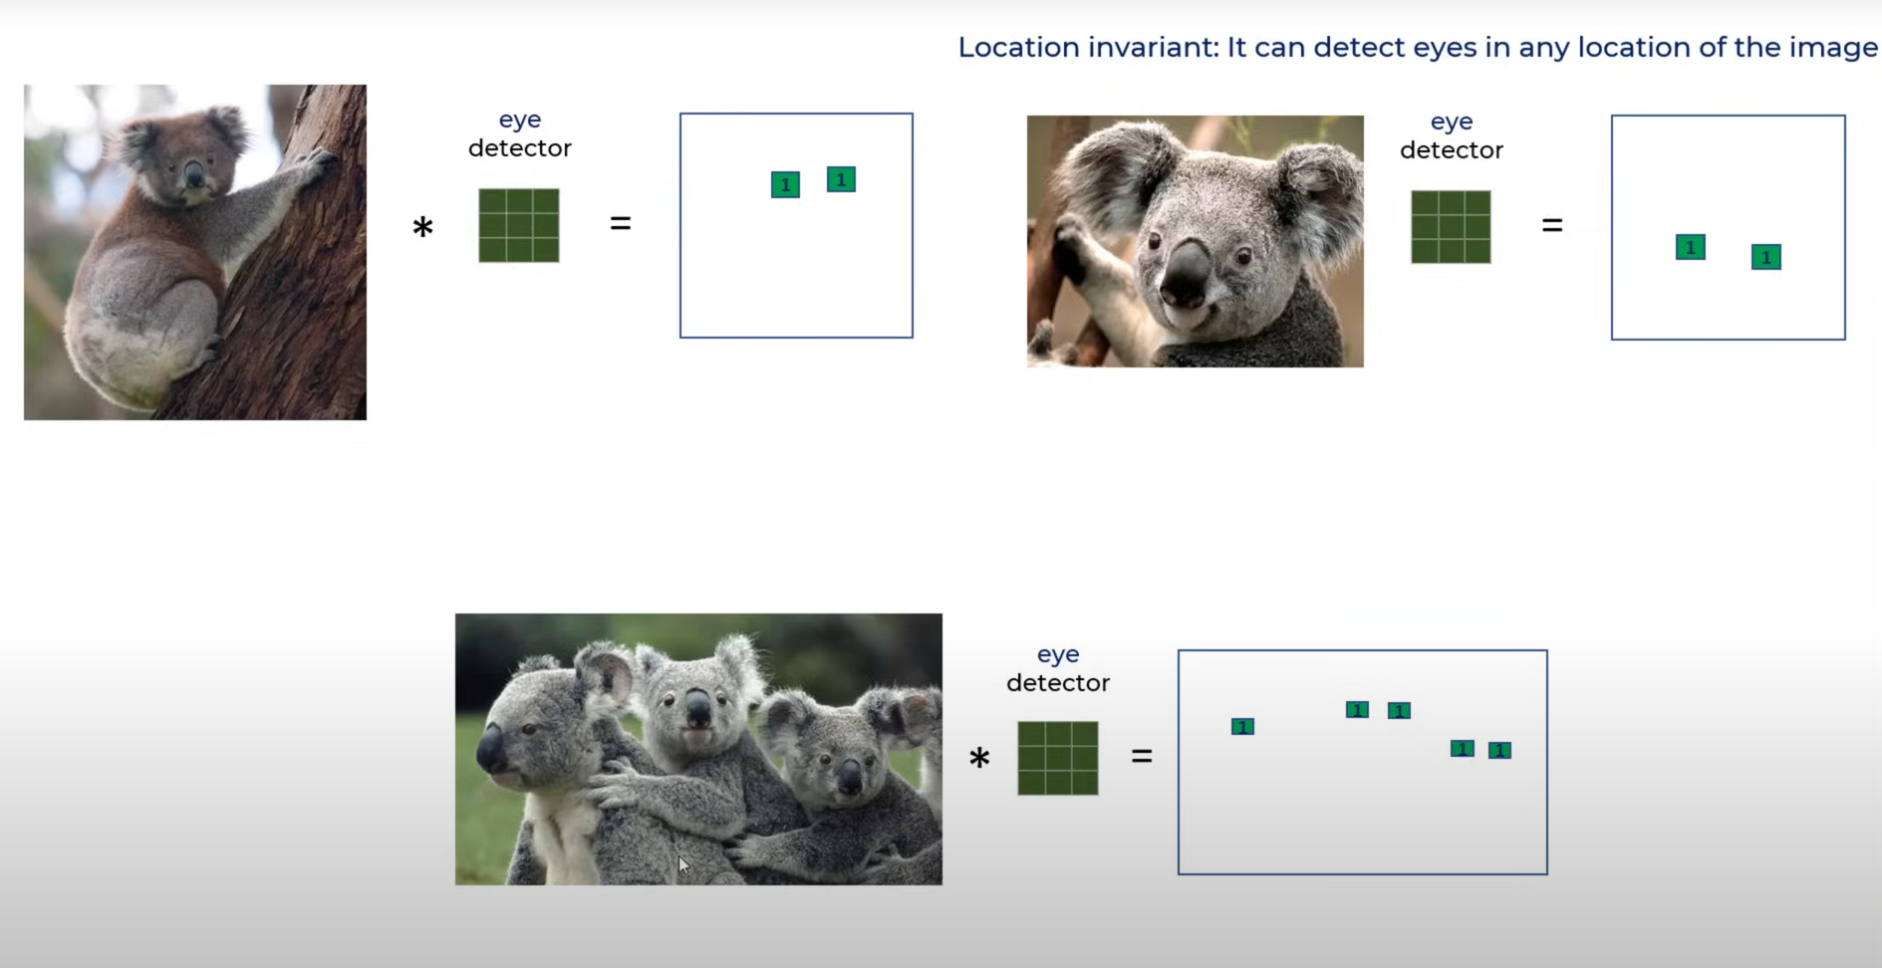

Slide 7
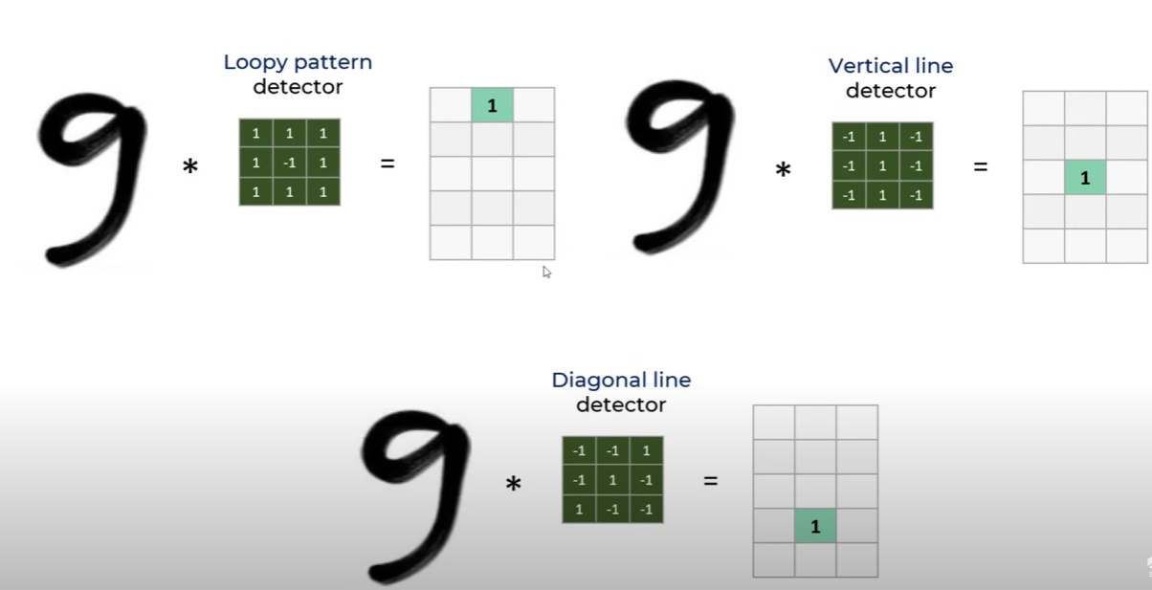

Slide 8
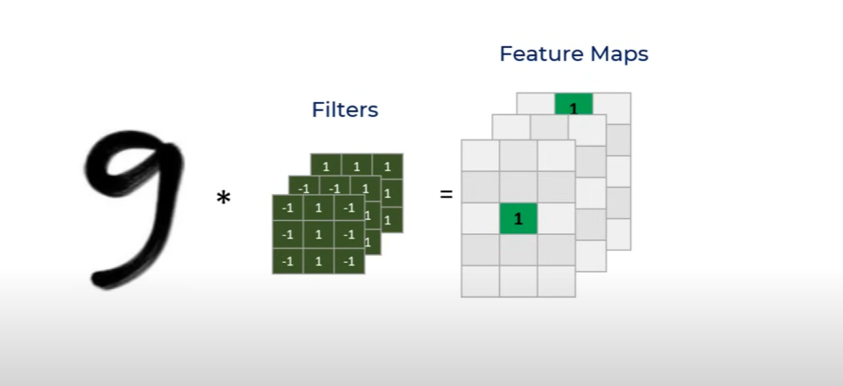

Slide 9
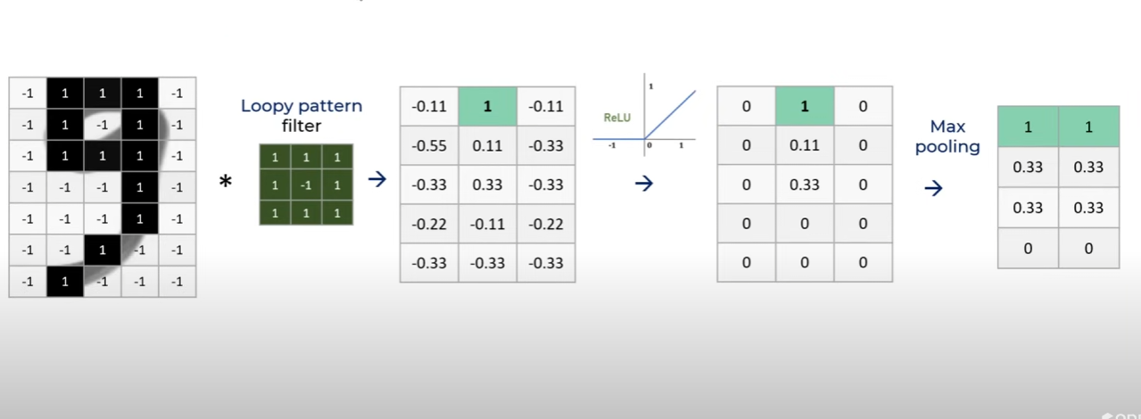

Slide 10
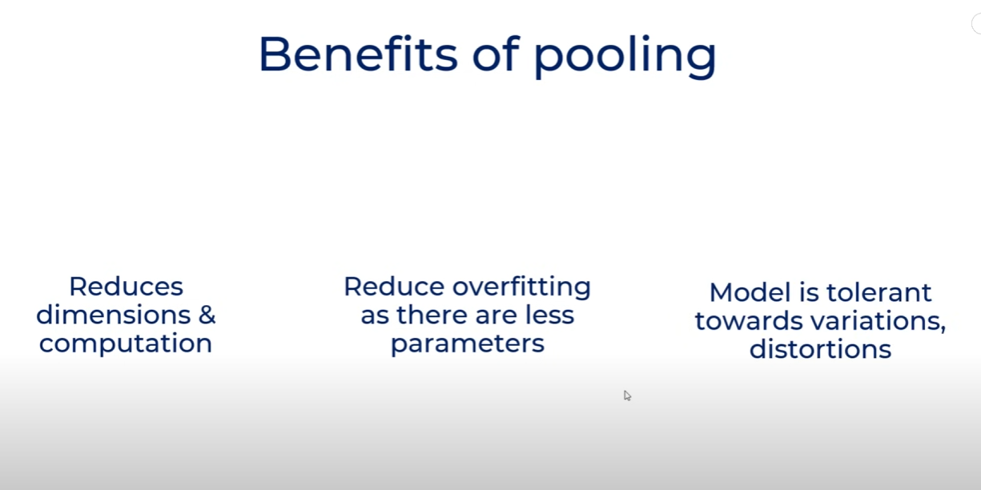

Slide 11
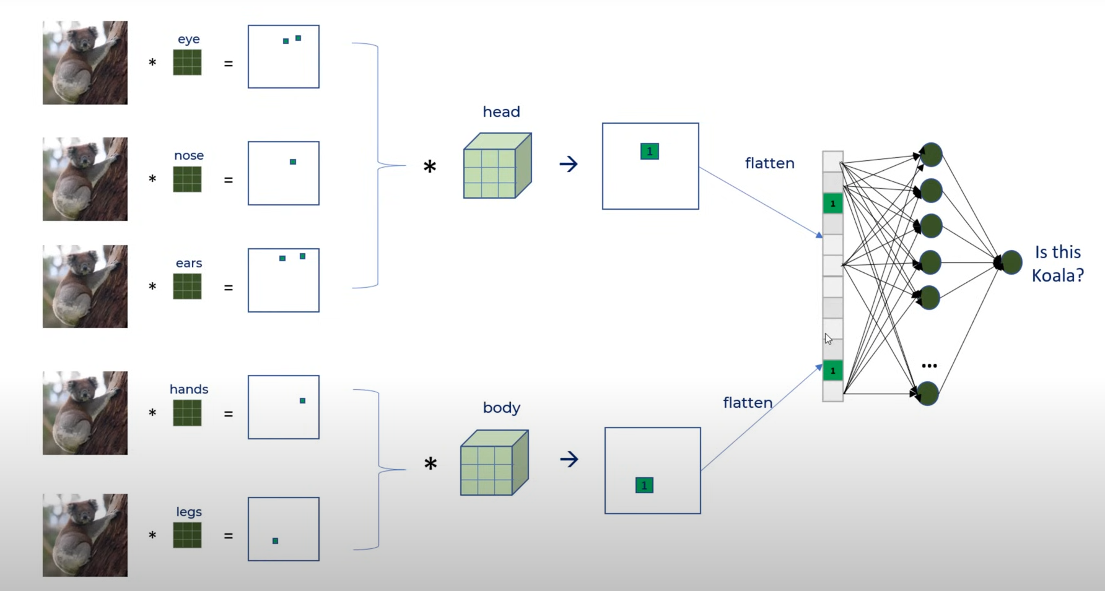

Slide 12
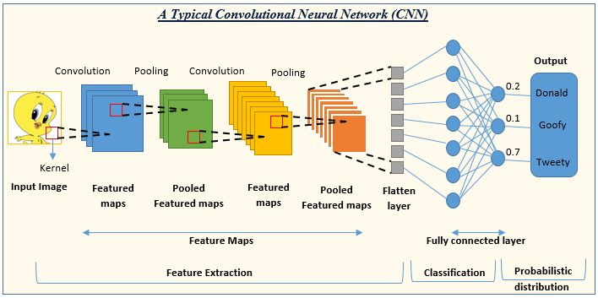

Slide 13
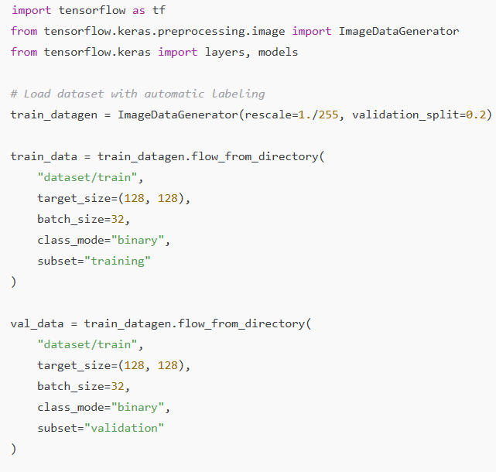
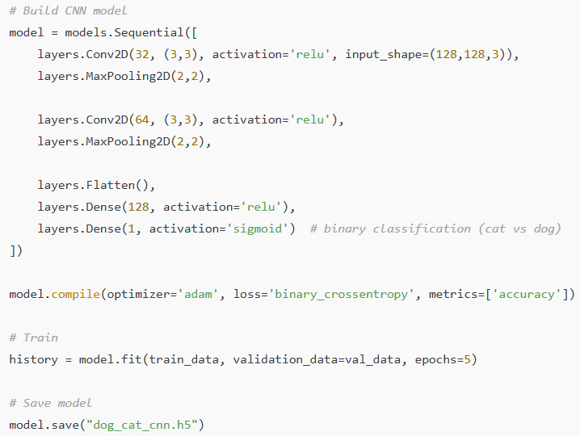

Slide 14
